Slide 1
Customizable Machine Monitoring and Control with Hazelcast Jet
Randy May
22 Apr, 2022

Slide 2
Agenda

Slide 3
The Scenario
Georgia Automation and Control is implementing a new solution targeted at small to medium factories. The solution will allow an unprecedented level of customization. Customers will be able to set their own alerts, design custom machine control policies and, with minimal help, incorporate new machine types.
They are looking for a robust, scalable event processing engine to be the foundation for their next generation solution.

Slide 4
Main Functions
Customizable event processing.
Aggregate a granular event stream into chunkier summaries for processing by down stream systems.
What
Notes:
For example, 1s between monitor breached and alert sent

Slide 5
Key Requirements
Flexibility. It should be possible to implement any policy that can be coded.
Low Latency. Not more than 1 second between stimulus and response.
Scalability. As sensors are added or upgraded, event volume will increase. The solution should scale out gracefully.
Fault Tolerance. Failure of one host must not result in missed signals.
Operates in remote locations outside of the cloud or corporate data center
outside connectivity may be limited or intermittent
machines may have limited footprint
How

Slide 6
Hazelcast
When was it founded ?
How big is it ?
Who are the customers ? What are they doing with it ?
What do analysts say about it ?

Slide 7

Hazelcast
About Hazelcast
Hazelcast is the leading in-memory computing platform that allows organizations to leverage a highly resilient and elastic memory resource for data at rest and in motion. Our technology is behind many of today’s leading financial, e-commerce/retail, telecommunications, healthcare and government organizations. Whether it is real-time inventory and shipping information, lighting quick fraud detection or gleaning insights that lead to product innovation, Hazelcast enables companies to achieve success in microseconds.
About the Platform
Source: https://hazelcast.com/company/

Slide 8
Hazelcast Jet
Let’s have a look:
https://hazelcast.com/customers/
https://hazelcast.com/products/stream-processing/
Stream Processing Architecture Overview

Slide 9
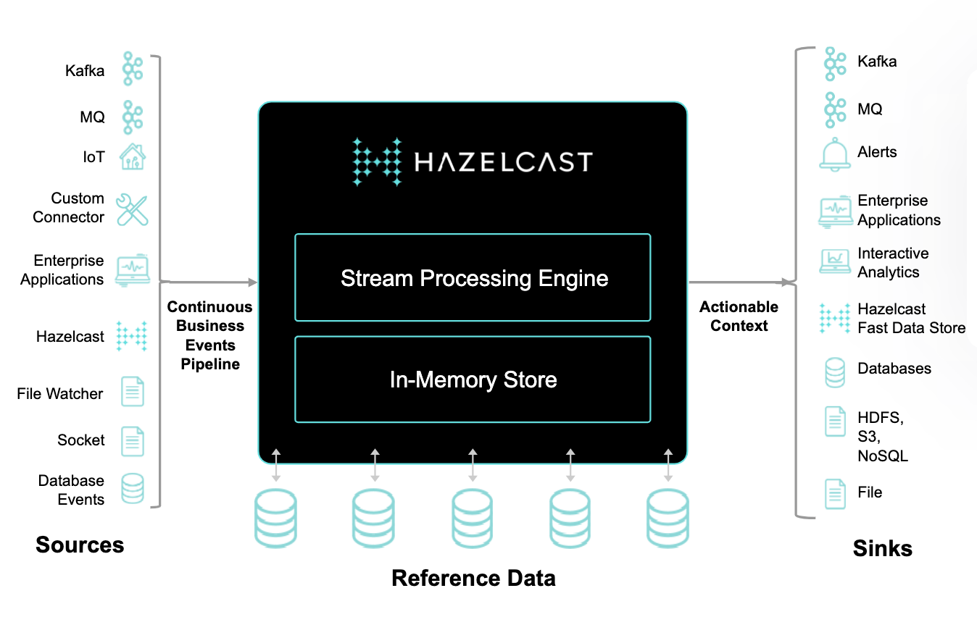
Hazelcast Stream Processing
Reference Architecture
Source: https://hazelcast.com/products/hazelcast-platform/

Slide 10
Introduction to Hazelcast Stream Processing
The foundation – time tested IMDG distributed data structures
The programming model
How pipelines are executed on the cluster
Operational features
Checkpointing and restart

Slide 11
Solution Overview

Slide 12
Demo
The scenario
The factory contains a large number of CNC cutting machines. Each machine can report fine-grained data including cutter temperature and also current x, z and z position of the cutter. We want to implement the following policies:
If the cutter temperature reaches a certain threshold, and assuming there are no movement anomalies, send a signal to reduce spindle-speed and feed rate. If the situation does not improve within 1 minute, shut off the machine and raise an alert.
Rapid changes velocity in the xy plane can indicate that the machine has been jarred or a bit has broken. The velocity can be calculated from a recent history of xy positions. This condition should be “turned off” when the z position of the bit indicates that it is above the material thickness for this job. Once the z-position is below the material thickness (i.e. the tool is cutting) then this monitor should become active.

Slide 13
Open Discussion
Questions ?
Next Steps

Slide 14

Thank You!

